Slide 1
Artistic Gymnastics
The Individual All Round Artistic Gymnastics competition consists of 6 apparatus for men and 4 for women.
Judges give the gymnast a score out of 10 for
the difficulty of the routine and
for the execution (how well they performed the routine).
The difficulty and the execution are added together to give the score for the apparatus.
The overall score for the event is the sum of all 6 or 4 apparatus scores.
Male All Rounder Apparatus
Vault
Floor Exercise
Pommel horse
Still rings
Parallel bars
High bars
Women All Rounder Apparatus
Vault
Floor Exercise
Uneven bars
Balance beam
Note to Teachers;
Australian Curriculum links are in the notes section of slides.

Slide 2
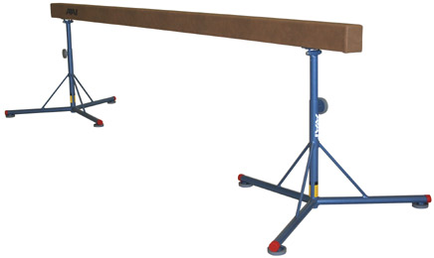
Balance Beam
A balance beam is 500cm long, 10cm wide and 125 cm high.
Notes:
Prep – Use direct and indirect comparisons to decide which is longer, heavier or holds more and explain reasoning in everyday language.
Year 1 – Measure and compare the lengths and capacities of pairs of objects using uniform informal units.
Year2 – compare and order several shapes and objects based on length, area, volume and capacity using appropriate uniform informal units.
Year 3 – Measure, order and compare objects using familiar metric units of length, mass and capacity.

Slide 3
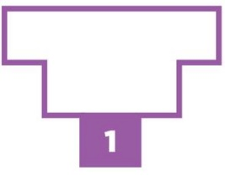
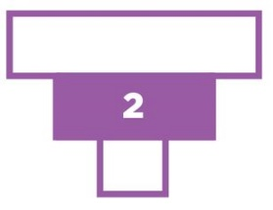
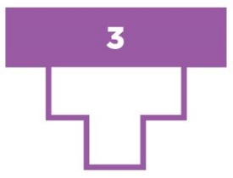
Men’s Individual All-Around Final
Gymnast | Country | Result
Oleg Verniaiev | Ukraine | 92.266
Sergio Sasaki | Brazil | 89.198
Kohen Uchimura | Japan | 92.365
Samuel Mikulak | USA | 89.565
Max Whitlock | Great Britain | 90.641
Chaopan Lin | China | 90.230
Use a number line to order the gymnasts' results.
Which competitor/s scored between 90.5 and 91?
Which competitor/s scored between 90.25 and 990.75?
www.learningyou.com.au
Notes:
Year 5 – recognise that the place value system can be extended beyond hundredths.
Compare order and represent decimals.

Slide 4
Notes:
Year 6 – Add and subtract decimals, with and without digital technologies and use estimation and rounding to check the reasonableness of answers.
Year 7 – round decimals to a specified number of decimal places.

Slide 5
Notes:
Year 6 – Add and subtract decimals, with and without digital technologies and use estimation and rounding to check the reasonableness of answers.
Year 7 – round decimals to a specified number of decimal places.

Slide 6
Notes:
Year 7 – Calculate mean, median, mode and range for sets of data. Interpret these statistics in the context of data.
Year 8 – Explore the variation of means and proportions in of random samples drawn from the same population.

