Slide 1
Thousands
Try this equation in your head.
Do NOT use a calculator.
Do NOT use a pencil and paper.
Teacher to read the following:
Take 1000 and add 40 to it. Now add another 1000 to it. Now add 30.
Add another 1000. Now add 20. Now add another 1000. Now add 10.
What’s your total?

Slide 2
Thousands
Teacher to read the following:
Take 1000 and add 40 to it. Now add another 1000 to it. Now add 30.
Add another 1000. Now add 20. Now add another 1000. Now add 10.
What’s your total?

Slide 3
Thousands
Take 1000 and add 40 to it. Now add another 1000 to it. Now add 30.
Add another 1000. Now add 20. Now add another 1000. Now add 10.
What’s your total?

Slide 4
Thousands
Take 1000 and add 40 to it. Now add another 1000 to it. Now add 30.
Add another 1000. Now add 20. Now add another 1000. Now add 10.
What’s your total?
Identify the steps
Most people say 5000!
The correct answer is 4100.
1000 + 40 + 1000 + 30 + 1000 + 20 + 1000 + 10 = 4100

Slide 5
Most people say 5000!
BUT they are wrong.
What was there error?
Why?
How can you avoid making this error?

Slide 6
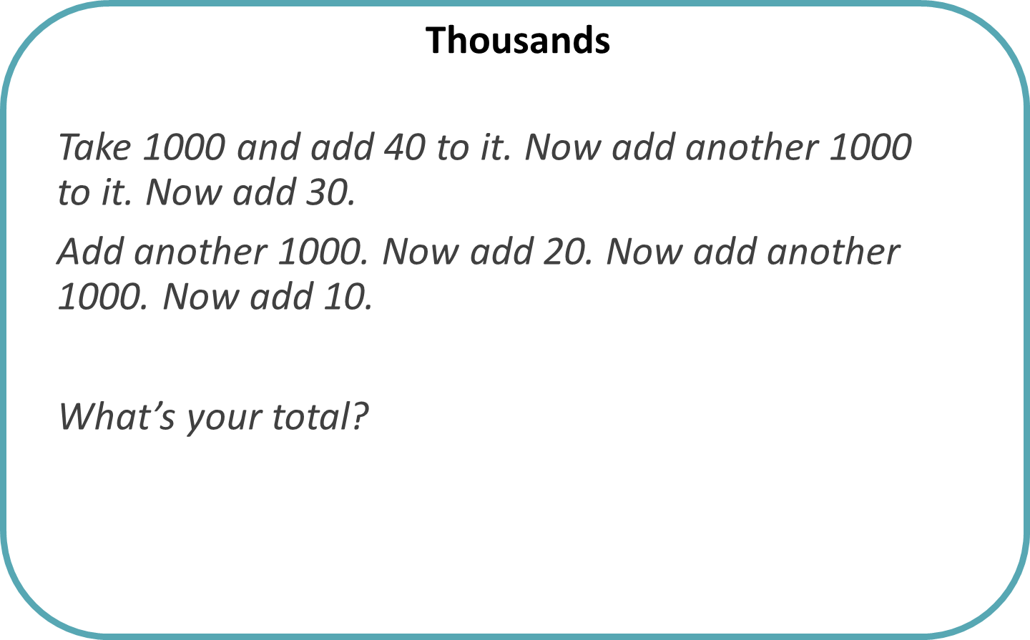
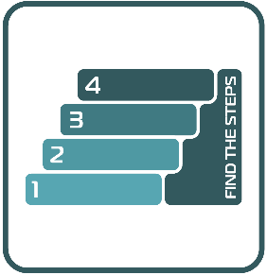
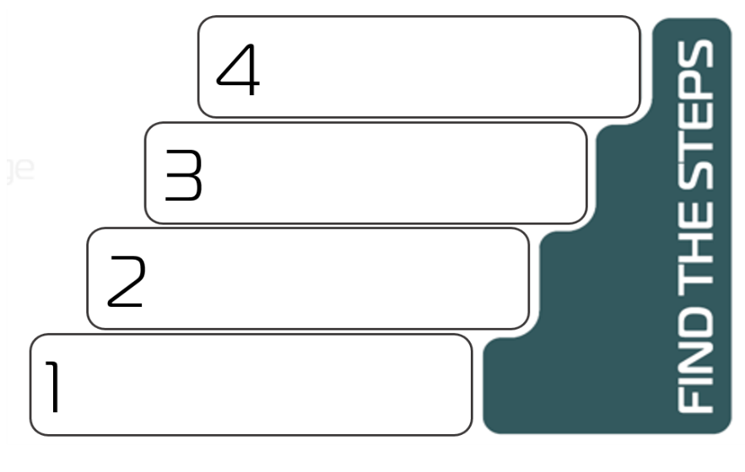
PLAN
= ?
+ 10
+ 1000
+ 20
+ 1000
+ 30
+ 1000
+ 40
1000

