Slide 1
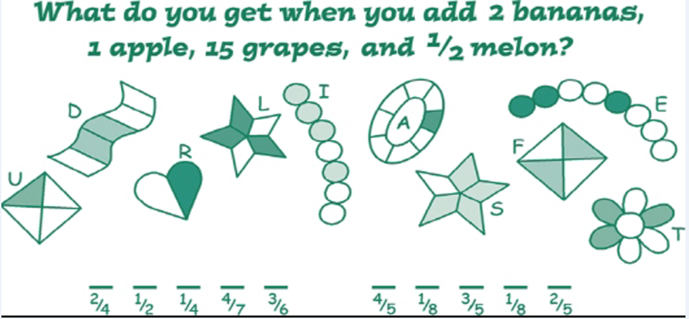
Genius Brain Teasers (Primary)
Reference: www.geniusbrainteasers.com

