Slide 1
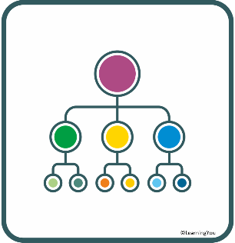
80 vehicles
60 car
truck
red
green
red
9 green
PLAN
Does a diagram help? Why? Why not?

Slide 2
There are two variables – colour and type of vehicle. A two way table is a great way to organise this information.
PLAN
Variable 1 provides headings for the columns
 |  | Colour of vehicle |  | Total
 |  | Red | Green
Type of Vehicle | Car | ? |  | 60
 | Truck |  | 9
Total |  | 35 |  | 80
Colours can help you “see” the information.
Variable 2provides headings for the rows
Can you fill in some empty cells?

Slide 3
There are two variables – colour and type of vehicle. A two way table is a great way to organise this information.
PLAN
Variable 1 provides headings for the columns
 |  | Colour of vehicle |  | Total
 |  | Red | Green
Type of Vehicle | Car | 24 |  | 60
 | Truck | 11 | 9 | 20
Total |  | 35 |  | 80
Colours can help you “see” the information.
Variable 2provides headings for the rows
Can you fill in some empty cells?

Slide 4
Carpark
A car park contains 80 vehicles. Each vehicle is either a car or a truck, and each vehicle is either red or green. 35 vehicles are red, and 60 vehicles are cars. If there are 9 green trucks, how many red cars are there?
Record the information you know from the question
Reference: GRE Maths Tricks
80 | Red | Green
Car |  |  | 60
Truck |  | 9
 | 35

Slide 5
Carpark
A car park contains 80 vehicles. Each vehicle is either a car or a truck, and each vehicle is either red or green. 35 vehicles are red, and 60 vehicles are cars. If there are 9 green trucks, how many red cars are there?
You can then start using the information you have to work out other information
If there are 60 cars. The remaining vehicles must be trucks up to a total of 80. So, put 20 in the total trucks box.
Reference: GRE Maths Tricks
80 | Red | Green
Car |  |  | 60
Truck |  | 9 | 20
 | 35

Slide 6
Carpark
A car park contains 80 vehicles. Each vehicle is either a car or a truck, and each vehicle is either red or green. 35 vehicles are red, and 60 vehicles are cars. If there are 9 green trucks, how many red cars are there?
if there are 20 trucks and 9 are green. The remaining 11 must be red.
Reference: GRE Maths Tricks
80 | Red | Green
Car |  |  | 60
Truck | 11 | 9 | 20
 | 35

Slide 7
Carpark
A car park contains 80 vehicles. Each vehicle is either a car or a truck, and each vehicle is either red or green. 35 vehicles are red, and 60 vehicles are cars. If there are 9 green trucks, how many red cars are there?
if there are 35 red vehicles and 11 are trucks. The remaining 24 must be cars.
Reference: GRE Maths Tricks
80 | Red | Green
Car | 24 |  | 60
Truck | 11 | 9 | 20
 | 35

