Slide 1
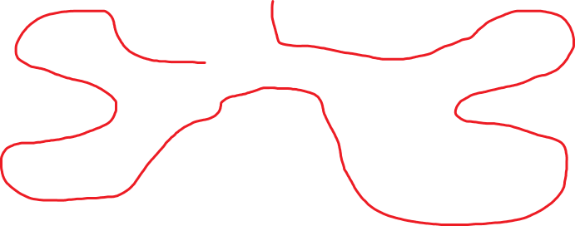
Can You Do It Solution
The line must finish in the family room.
de Mestre, N., & Duncan, B. (1980). Sixty Tasks from the A.C.T. Maths Centre. Canberra: Curriculum Development Centre.

