Slide 1
Does a picture or imagining how it would work help?
PLAN
What questions do you think of?
80 bricklayers
80 000 bricks
What operations might work?
Are there parts or groups?
Day 1
Day 2
Day 3
Day 4
Day 5
Day 6
Day 7
Day 8
8 days

Slide 2
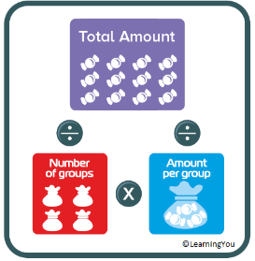
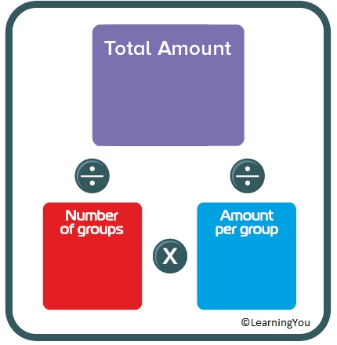
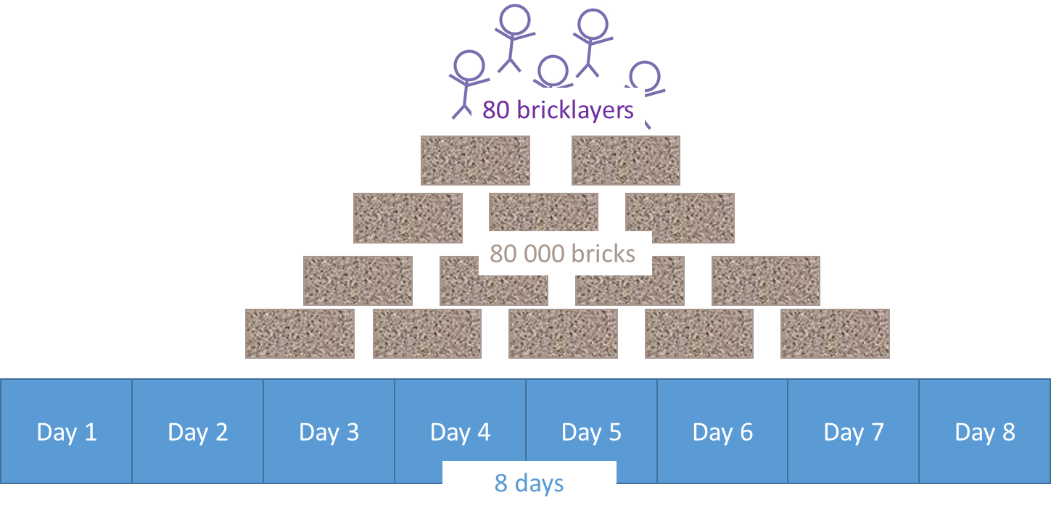
PLAN
How many bricks per day?
80 000
8
80 000 ÷ 8 = 10 000 per day

Slide 3
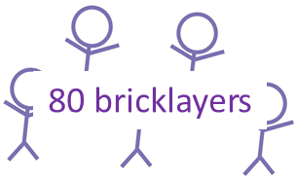
PLAN
In one day
In one day
How many bricks will 1 bricklayer lay per day?
10 000
1 bricklayer
lay
80
lays
10 000 bricks
? bricks
10 000 ÷ 8 = 125 per day

Slide 4
PLAN
In one day
In one day
How many bricks will 40 bricklayers lay per day?
1 bricklayer
40 bricklayer
lays
will lay
40
125
125 bricks
? bricks
40 x 125= 5000 bricks

Slide 5
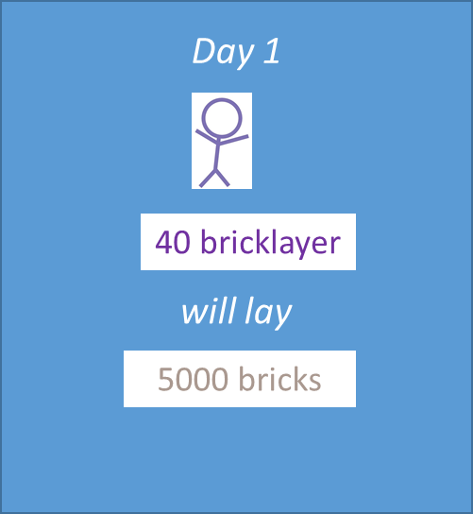
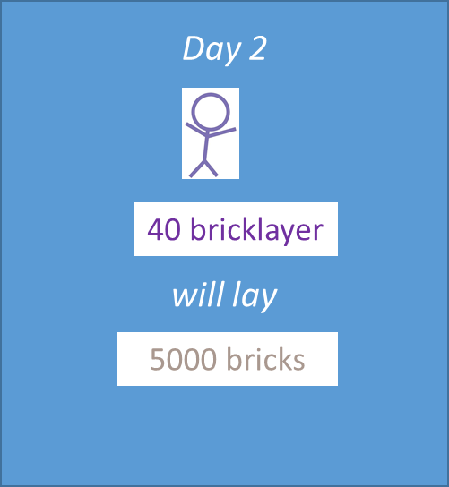
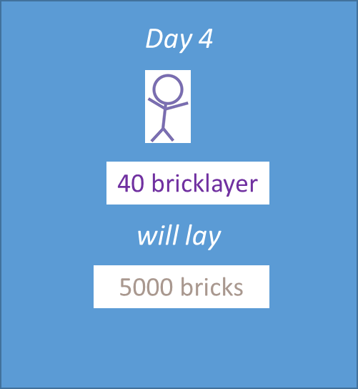
PLAN
In one day
How many bricks will 40 bricklayers lay in 4 day?
40 bricklayer
4
5000
will lay
5000 bricks
4 x 5000 = 20 000 bricks

Slide 6
A lot of people think the answer is 40 000.
What is faulty about their thinking?

Slide 7
Bricks (Secondary)
On a building site, 80 bricklayers lay 80 000 bricks in eight days. How many bricks do 40 bricklayers lay in 4 days?
Identify the steps
Step 1: Calculate bricks laid by 40 bricklayers in same time (8 days)
Step 2: Divide your answer in half due to half the time (4 days)
Step 1: 80 bricklayers = 80 000 bricks
40 bricklayers = 40 000 bricks
Step 2: 40 000 bricks ÷ 2 = 20 000 bricks
So, 40 bricklayers would lay 20 000 bricks in 4 days.

