Slide 1
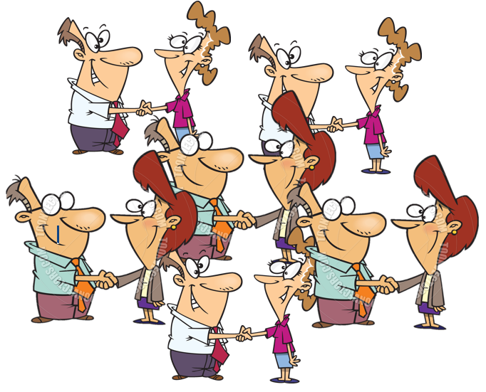
A Shaker’s Dozen
Twelve friends meet and shake hands with each other.
How many handshakes were there altogether in this exchange?
Moscovich, I. (2004). The Monty Hall Problem & Other Puzzles. New York: Sterling Publishing Co.

