Slide 3
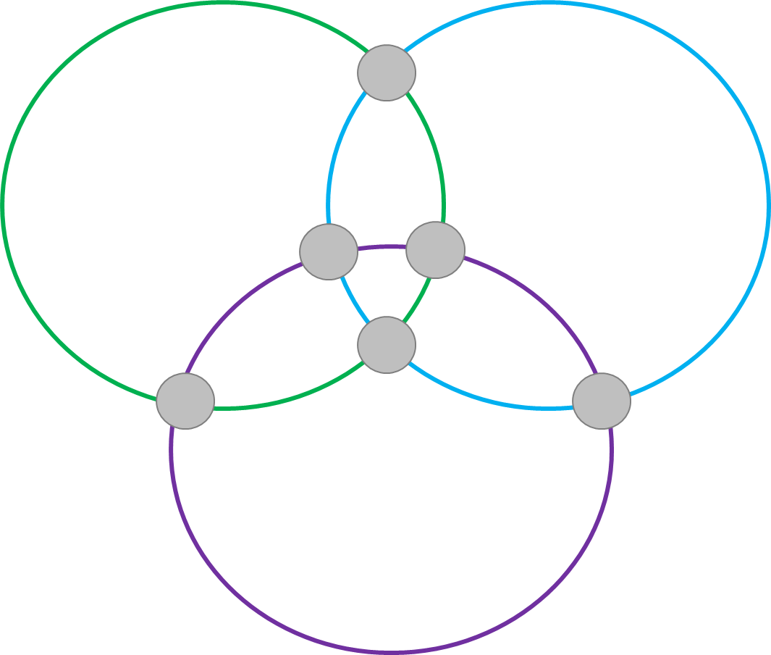
Interlocking Magic Circles 1.
1
5
6
4
2
3

Slide 4
Interlocking Magic Circles 1.
Extension
3
5
6
4
7
8

Slide 5
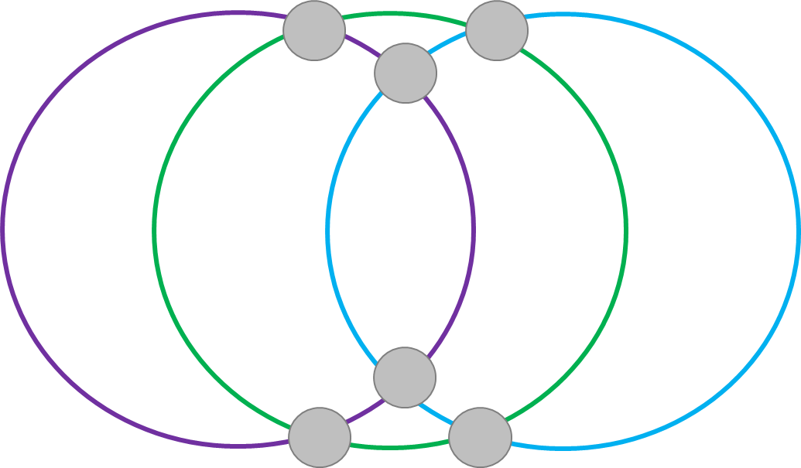
Interlocking Magic Circles 2.
Extension
7
5
6
4
2
3

Slide 6
Interlocking Magic Circles 2.
Extension
3
5
6
4
7
8

